Slide 1
Introduction to MongoDB

Slide 2
Objectives
Explain the salient features of MongoDB
Understand the difference between SQL and NoSQL databases
Install and run a MongoDB server
Interaction (CRUD) with MongoDB from the mongo REPL shell

Slide 3
Database overview

Slide 4
Databases
Databases are used to store structured information
Databases support various operations on the data
– Query
– Insert
– Update
– Delete

Slide 5
NoSQL Databases
SQL (structured query language) based relational databases have been very popular means of storing data
NoSQL databases are increasingly becoming popular to address some challenges encountered with SQL databases
Four broad categories:
– Document databases (e.g., MongoDB)
– Key-value databases (e.g., Redis)
– Column-family databases (e.g., Cassandra)
– Graph databases (e.g., Neo4J)

Slide 6
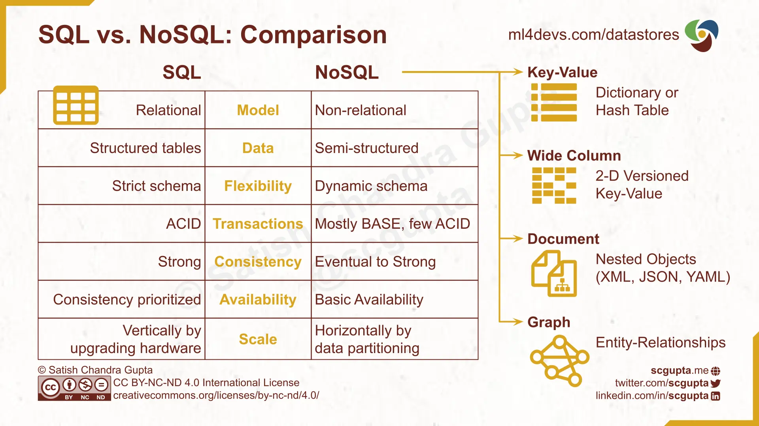
Difference between SQL and NoSQL databases

Slide 7
Document Databases
Document: A self-contained piece of information
– E.g., a JSON document:
{
“name”: “Uthapizza”,
“description”: “A unique combination . . .”
}
Collection: collection of documents
Database: A set of collections

Slide 8
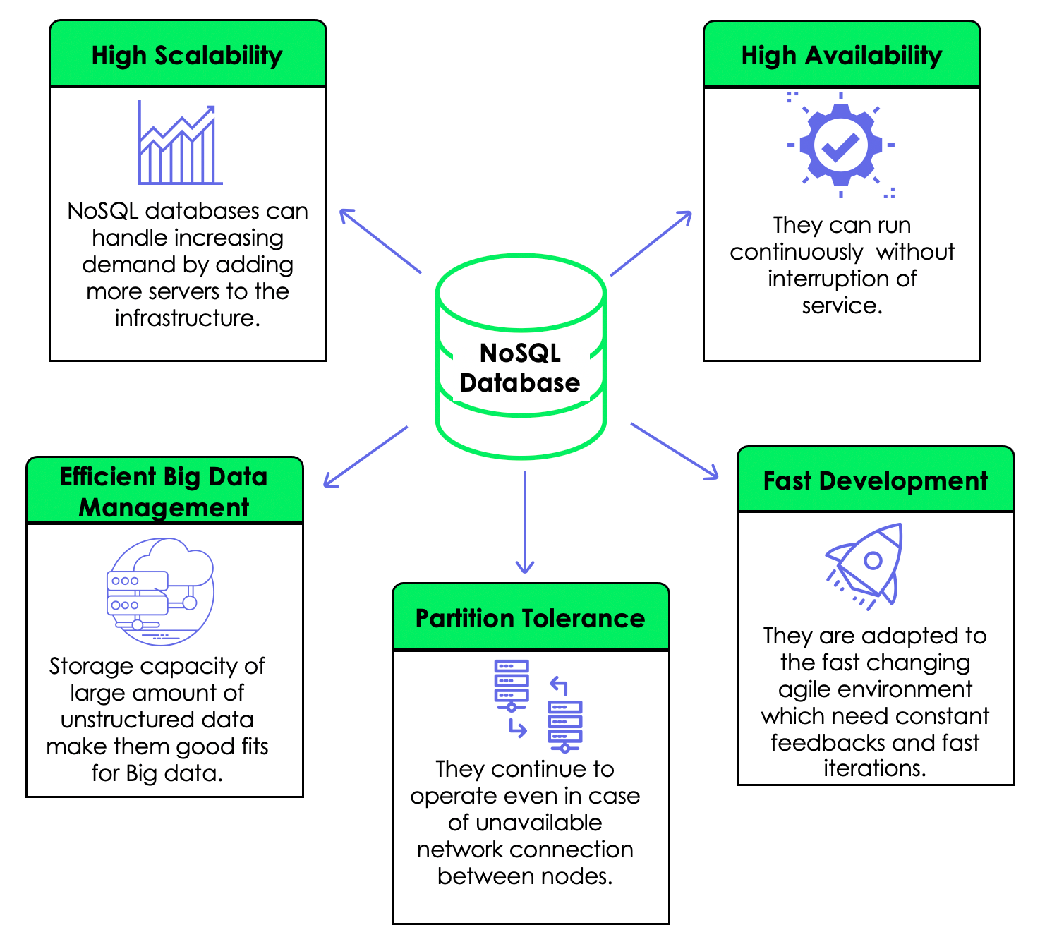
Why NoSQL?
Scalability
– Availability
– Consistency – Partition tolerance
Ease of deployment
– No object-relation mapping required.

Slide 9
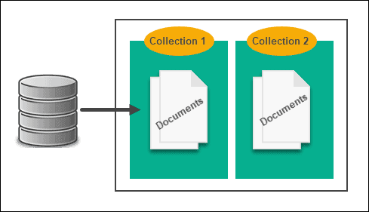
MongoDB
Document Database
Server can support multiple databases
A database consists of a set of collections
A collection is a set of documents
Document is effectively a JSON document with some additional features

Slide 10
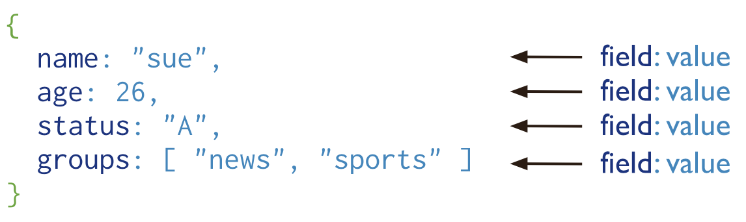
MongoDB Format
Mongo stores the documents in BSON (Binary JSON) format
Supports length prefix on each value
Easy to skip over a field
Information about the type of a field value
Additional primitives types not suppported by raw JSON like UTC date time, raw binary, and ObjectId

Slide 11
MongoDB ObjectId
Every document in Mongo must have an “_id” field that is unique
Default ObjectId created by Mongo when you insert a document
Example:
{
"_id" : ObjectId("56ce74c0b02806eff4558f1f"),
"name" : "Uthapizza", "description" : "Test"
}

Slide 12
MongoDB ObjectId
ObjectId is a 12 byte field:
id.getTimestamp() returns the timestamp in ISO Date format.

Slide 13
Downloading and Installing MongoDB

Slide 14
Downloading and Installing MongoDB
Install on Windows:
https://www.mongodb.com/docs/manual/tutorial/install-mongodb-on-windows/
Install on MacOS:
https://www.mongodb.com/docs/manual/tutorial/install-mongodb-on-os-x/
Install on Linux
https://www.mongodb.com/docs/manual/administration/install-on-linux/

Slide 15
Interaction with MongoDB using the Mongo REPL shell
After successful installation, to run MongoDB ready to work, enter the following command in terminal:
On MacOS:
brew services start mongodb/brew/mongodb-community
Stop MongoDB:
On MacOS:
brew services stop mongodb/brew/mongodb-community

Slide 16
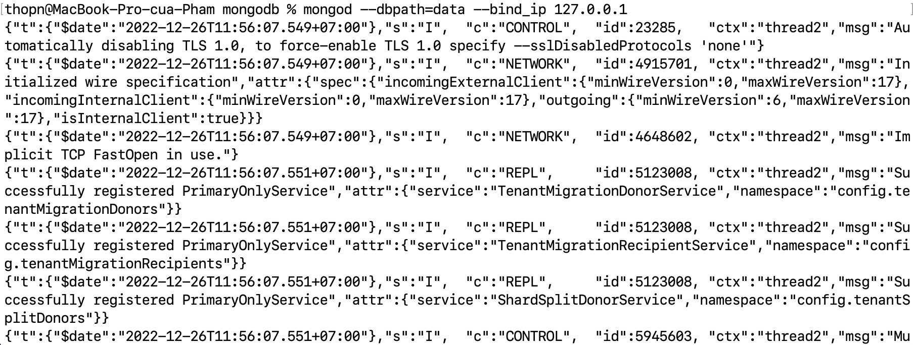
Interaction with MongoDB using the Mongo REPL shell
Create a folder named mongodb on your computer and create a subfolder under it named data.
Move to the mongodb folder and then start the MongoDB server by typing the following at the prompt:
mongod --dbpath=data --bind_ip 127.0.0.1

Slide 17
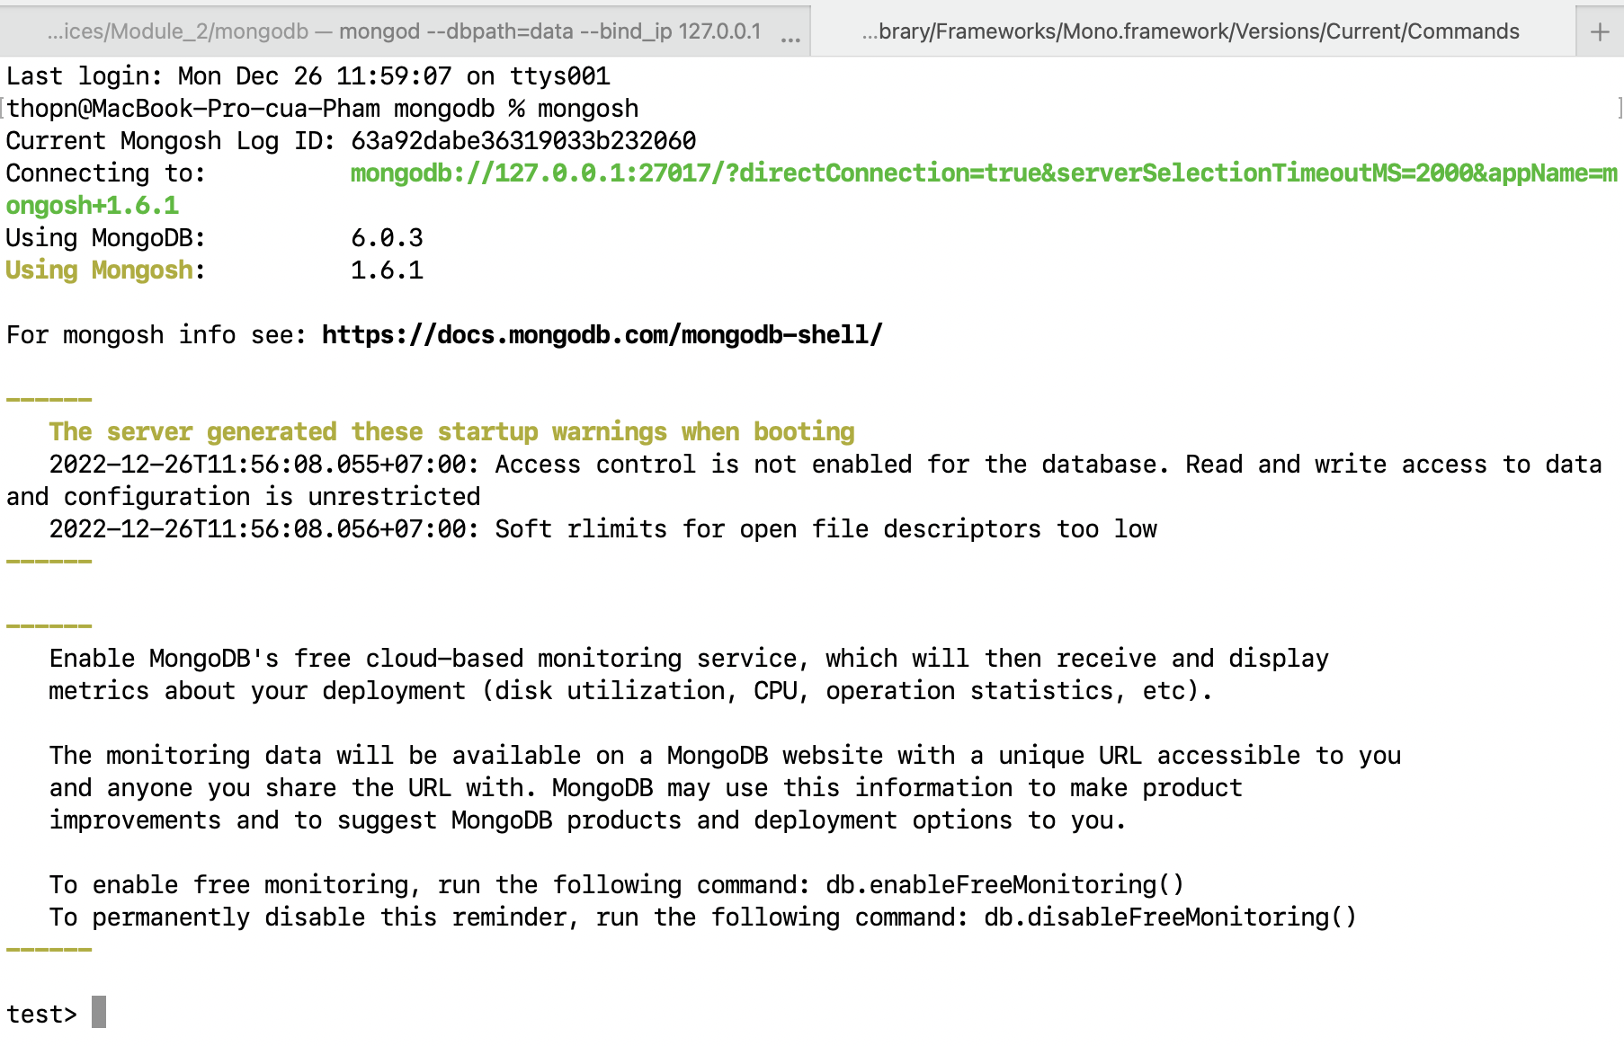
Interaction with MongoDB using the Mongo REPL shell
Open another command window and then type the following at the command prompt to start the mongo REPL shell:
mongosh

Slide 18
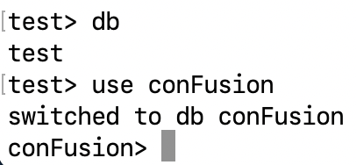
Create a new Database
The Mongo REPL shell will start running and give you a prompt to issue commands to the MongoDB server. At the Mongo REPL prompt, type the following commands one by one and see the resulting behavior:

Slide 19
MongoDB CRUD Operations

Slide 20
Create Operations
Create or insert operations add new documents to a collection. If the collection does not currently exist, insert operations will create the collection.
MongoDB provides the following methods to insert documents into a collection:
db.collection.insertOne()
db.collection.insertMany()

Slide 21
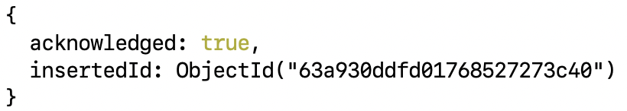
Create Operations
You will now create a collection named dishes, and insert a new dish document in the collection:
The operation returns:

Slide 22
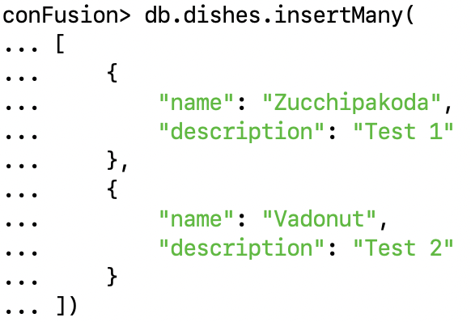
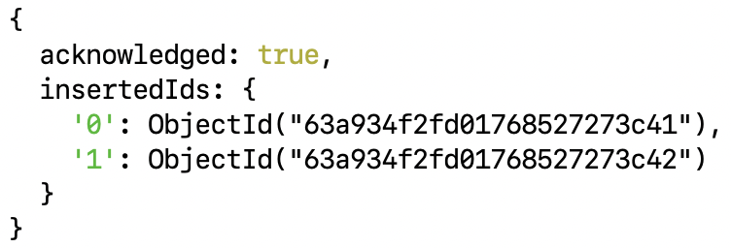
Create Operations
Insert Multiple Documents:
Insert multiple dish document into the dishes collection:
The operation returns:

Slide 23
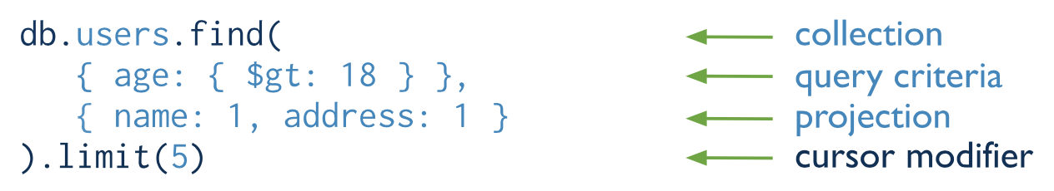
Read Operations
Read operations retrieve documents from a collection; i.e. query a collection for documents. MongoDB provides the following methods to read documents from a collection:
db.collection.find()
We can specify query filters or criteria that identify the documents to return.

Slide 24
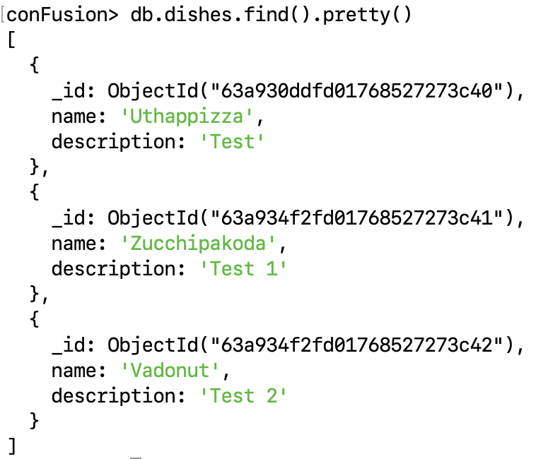
Read Operations
Then to print out the dishes in the collection, type:
Or
Note the "_id" assigned to the dish.

Slide 25
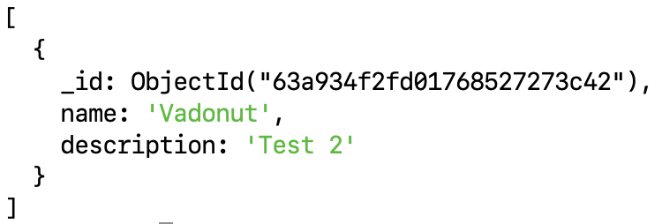
Read Operations
Find all the dishes with name is “Vadonut”
The operation returns:

Slide 26
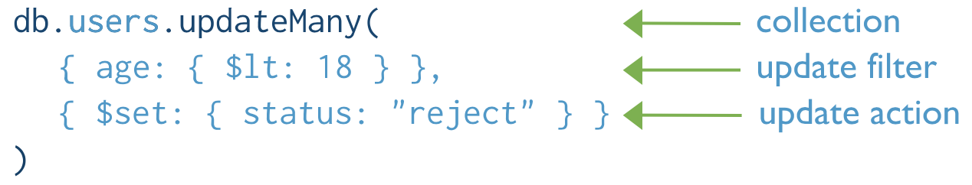
Update Operations
Update operations modify existing documents in a collection. MongoDB provides the following methods to update documents of a collection:
db.collection.updateOne()
db.collection.updateMany()
db.collection.replaceOne()
We can specify criteria, or filters, that identify the documents to update. These filters use the same syntax as read operations.

Slide 27
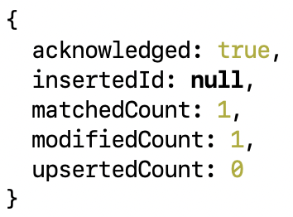
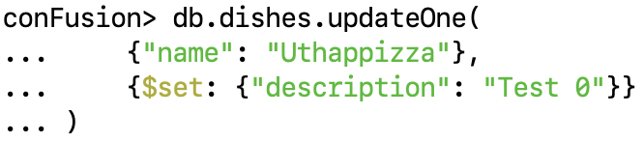
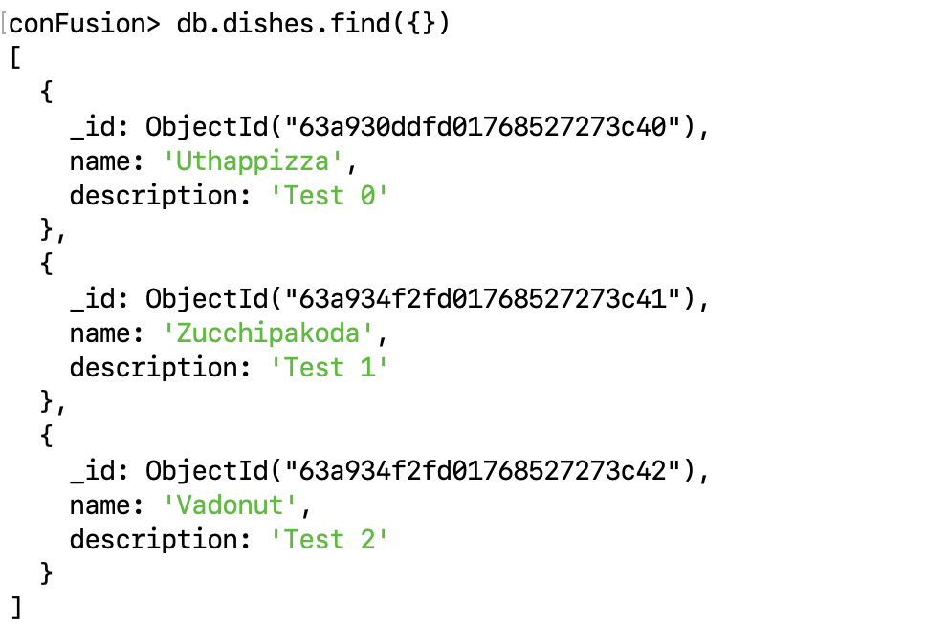
Update Operations
Example:
Collection updated:
The operation returns:

Slide 28
Delete Operations
Delete operations remove documents from a collection. MongoDB provides the following methods to delete documents of a collection:
db.collection.deleteOne()
db.collection.deleteMany()
Example:
The operation returns:

Slide 29
Summary
Explain the salient features of MongoDB. Understand the difference between SQL and NoSQL databases
Install and run a MongoDB server and interact with it from the mongo REPL shell
Create a new collection
Insert one, insert many document into collection
Print out the documents in the collection.

